Slide 1
Digital Portfolio
STUDENT NAME: priyanka
REGISTER NO AND NMID:asunm112401111033029
DEPARTMENT: BCA
COLLEGE: LNGovernment college/ Madras University

Slide 2
PROJECT TITLE
Digital portfolio

Slide 3


AGENDA
Problem Statement
Project Overview
End Users
Tools and Technologies
Portfolio design and Layout
Features and Functionality
Results and Screenshots
Conclusion
Github Link
3/21/2024 Annual Review

Slide 4

PROBLEM STATEMENT
Many students and professionals struggle to present their skills, projects, and achievements in an organized and accessible way. Traditional resumes often fail to showcase creativity, hands-on projects, and technical expertise effectively. There is a need for a digital portfolio that highlights individual talent, technical skills, and professional growth in a visually appealing manner.

Slide 5

PROJECT OVERVIEW
This project focuses on developing a Digital Portfolio Website that represents an individual’s academic background, skills, certifications, and projects. The portfolio will act as a personal branding tool and an online resume, enabling recruiters and institutions to assess the candidate’s capabilities more effectively.

Slide 6

WHO ARE THE END USERS?
Students – to showcase their academic achievements and projects. Job Seekers – to present their skills and certifications to recruiters. Recruiters/Employers – to evaluate candidates beyond a paper resume. Colleges/Universities – to guide and support students in career placements

Slide 7

TOOLS AND TECHNIQUES
Frontend: HTML, CSS, JavaScript Frameworks: Bootstrap / React (optional) Backend (if required): Node.js / PHP / Django Database: MySQL / Firebase Version Control: Git & GitHub Design Tools: Figma / Canva for UI design

Slide 8
POTFOLIO DESIGN AND LAYOUT
Home Page: Brief introduction, photo, tagline. About Me Section: Education, personal details, career objectives. Skills Section: Technical and soft skills with progress bars or icons. Projects Section: Highlight academic and personal projects with descriptions and links. Contact Section: Email, phone, LinkedIn, GitHub link. Responsive Design: Optimized for both desktop and mobile devices.
8

Slide 9
FEATURES AND FUNCTIONALITY
Easy navigation with interactive UI. Responsive design for all screen sizes. Integration of GitHub/LinkedIn profiles. Project showcase with images, links, and documentation. Contact form for direct communication. Dark/light theme toggle (optional).

Slide 10
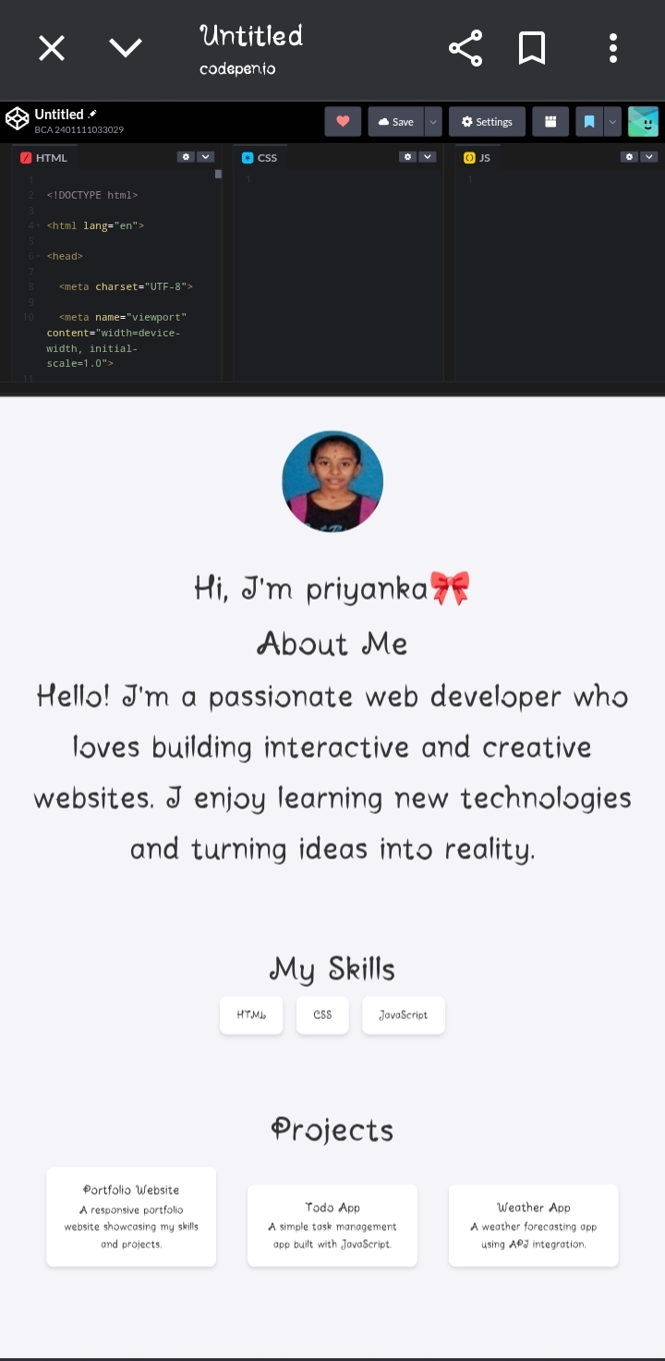
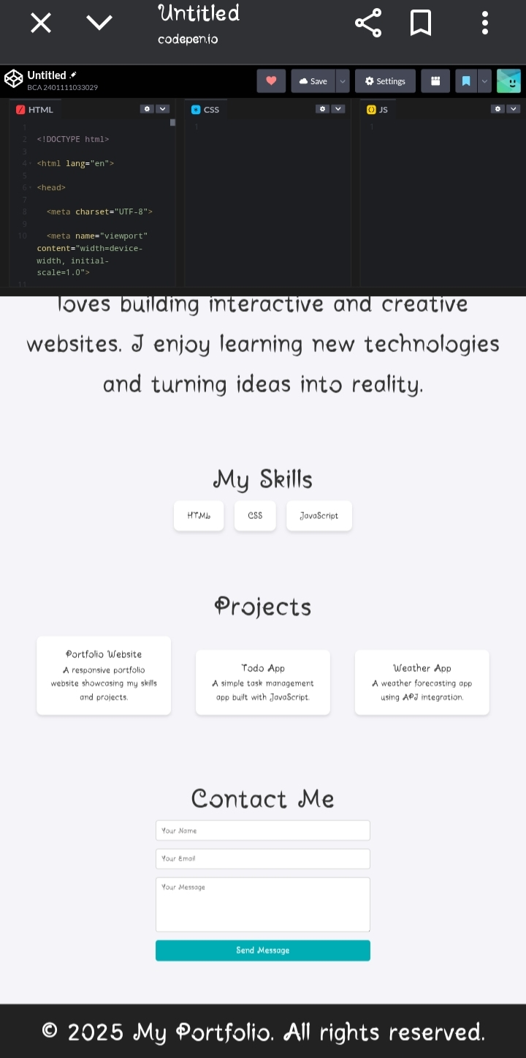

RESULTS AND SCREENSHOTS
3/21/2024 Annual Review
10

Slide 11
CONCLUSION
The digital portfolio provides a modern solution for showcasing professional identity, technical expertise, and personal achievements. It enhances job opportunities by creating a strong online presence and helps students and professionals stand out in competitive fields.
11

Slide 12
GitHub link

